Slide 1
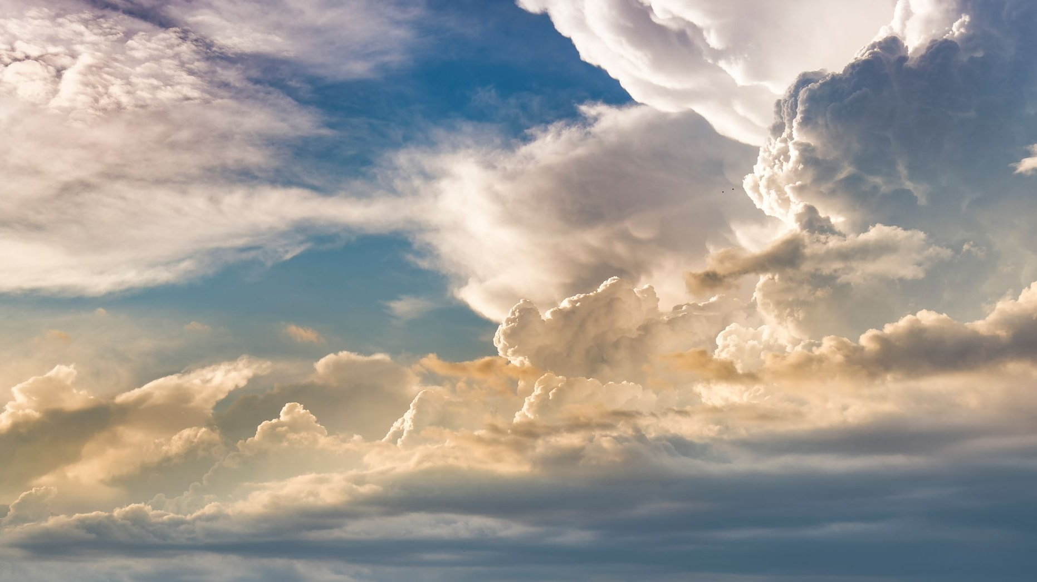
Blessed Is The Man…

Slide 2
we are blessed…
a conversation with God
a life of consecration
lifetime to be sanctified in Christ
Old Testament, New Testament

Slide 3
OLD TESTAMENT
E-sher [H835] : “happy” , honor from the Lord.
bera-KAH [H1293] : “prosperity”
Gen 12:1-2 Now the LORD had said unto Abram, Get thee out of thy country, and from thy kindred, and from thy father's house, unto a land that I will shew thee: 2 And I will make of thee a great nation, and I will bless thee, and make thy name great; and thou shalt be a blessing [H1293].
bara-k [H1288]: to “kneel” to bless God; or to “benefit” if God is sending the blessing to us.
Psa 34:1 …I will bless [H1288: reverence, symbolically kneel before], the LORD at all times: his praise shall continually be in my mouth.

Slide 4
E-sher Scriptures
Psa 1:1-2 Blessed [happy, honored by God] is the man that walketh not in the counsel of the ungodly, nor standeth in the way of sinners, nor sitteth in the seat of the scornful. 2 But his delight is in the law of the LORD; and in his law doth he meditate day and night.
Psa 32:1-2 …Blessed [happy, honored by God] is he whose transgression is forgiven, whose sin is covered. 2 Blessed [happy] is the man unto whom the LORD imputeth not iniquity, and in whose spirit there is no guile.
Psa 34:8 O taste and see that the LORD is good: blessed [happy] is the man that trusteth in him.
Psa 40:4 Blessed [happy] is that man that maketh the LORD his trust, and respecteth not the proud, nor such as turn aside to lies.
Psa 84:4-6 Blessed [happy] are they that dwell in thy house: they will be still praising thee. Selah. 5 Blessed [happy] is the man whose strength is in thee; in whose heart are the ways of them. 6 Who passing through the valley of Baca make it a well; the rain also filleth the pools.

Slide 5
E-sher Scriptures (2)
Psa 65:4 Blessed [happy] is the man whom thou choosest, and causest to approach unto thee, that he may dwell in thy courts: we shall be satisfied with the goodness of thy house, even of thy holy temple.
Psa 89:15 Blessed [happy] is the people that know the joyful sound: they shall walk, O LORD, in the light of thy countenance.
Psa 94:12 Blessed [happy] is the man whom thou chastenest, O LORD, and teachest him out of thy law;
Psa 119:1 ALEPH. Blessed [happy] are the undefiled in the way, who walk in the law of the LORD.
Psa 128:1 … Blessed is every one that feareth the LORD; that walketh in his ways.

Slide 6
N.T. Greek equivalent to the O.T. Hebrew
Psa 32:1-2 … Blessed [happy] is he whose transgression is forgiven, whose sin is covered. 2 Blessed [happy] is the man unto whom the LORD imputeth not iniquity, and in whose spirit there is no guile.
Rom 4:7-8 Saying, Blessed [fortunate, happy] are they whose iniquities are forgiven, and whose sins are covered. 8 Blessed [happy] is the man to whom the Lord will not impute sin.

Slide 7
Greek words for “blessed”
Makarios [G3107]: supremely blest, fortunate, well off, happy x50
Makarizo (G3106]: pronounce fortunate x2
Eulogeo [G2127]: speak well of x44
Eulogetos [G2128]: adorable x8 [Eph 1:3]
Eneulogeo [1757]: to confer a benefit on x2 [Lk 1:48; jas 5:11]

Slide 8
Beatitudes, ‘The blesseds’: Mat 5:3-12
3 Blessed [happy, honored by God] are the poor in spirit: for theirs is the kingdom of heaven.
4 Blessed [fortunate, happy, honored by God]are they that mourn: for they shall be comforted.
5 Blessed are the meek: for they shall inherit the earth.
6 Blessed [happy] are they which do hunger and thirst after righteousness: for they shall be filled.
7 Blessed [happy to be thus honored by God]are the merciful: for they shall obtain mercy.
8 Blessed are the pure in heart: for they shall see God.
9 Blessed are the peacemakers: for they shall be called the children of God.
10 Blessed are they which are persecuted for righteousness' sake: for theirs is the kingdom of heaven.
11 Blessed are ye, when men shall revile you, and persecute you, and shall say all manner of evil against you falsely, for my sake.
12 Rejoice and be exceeding glad: for great is your reward in heaven: for so persecuted they the prophets which were before you.

Slide 9
Happifying, made Glad…
Psa 46:4 There is a river, the streams whereof shall make glad the city of God, the holy place of the tabernacles of the Most High.
Psa 46:4 There is a river [of salvation, of truth], the streams [even now]whereof shall make glad [happy for the honor of God’s grace] the city of God [the New Jerusalem, the Church even now], the holy place [the Sanctuary class,]of the tabernacles [dwelling] of the Most High.

Slide 10
Revelations…
Rev 1:3 Blessed is he that readeth, and they that hear the words of this prophecy, and keep those things which are written therein: for the time is at hand.
Rev 14:13 And I heard a voice from heaven saying unto me, Write, Blessed are the dead which die in the Lord from henceforth: Yea, saith the Spirit, that they may rest from their labours; and their works do follow them.
[1Co 15:51-53 Behold, I shew you a mystery; We shall not all sleep, but we shall all be changed, 52 In a moment, in the twinkling of an eye, at the last trump: for the trumpet shall sound, and the dead shall be raised incorruptible, and we shall be changed. 53 For this corruptible must put on incorruption, and this mortal must put on immortality.]
Rev 16:15 Behold, I come as a thief. Blessed is he that watcheth, and keepeth his garments, lest he walk naked, and they see his shame.
Rev 19:9 And he saith unto me, Write, Blessed are they which are called unto the marriage supper of the Lamb. And he saith unto me, These are the true sayings of God.
Rev 20:6 Blessed and holy is he that hath part in the first resurrection: on such the second death hath no power, but they shall be priests of God and of Christ, and shall reign with him a thousand years.
Rev 22:7 Behold, I come quickly: blessed is he that keepeth the sayings of the prophecy of this book.

Slide 11
The “In between” (1)…
Mat 13:16 But blessed [fortunate, made glad, honored by God] are your eyes, for they see: and your ears, for they hear.
Luk 10:23 And he turned him unto his disciples, and said privately, Blessed[happy] are the eyes which see the things that ye see
Joh 20:29 Jesus saith unto him, Thomas, because thou hast seen me, thou hast believed: blessed are they that have not seen, and yet have believed.
Luk 12:37 Blessed are those servants, whom the lord when he cometh shall find watching: verily I say unto you, that he shall gird himself, and make them to sit down to meat, and will come forth and serve them.

Slide 12
The “In between” (2)…
Luk 1:45-55 And blessed [well off, happy, fortunate, supremely blest] is she that believed: for there shall be a performance of those things which were told her from the Lord. 46 And Mary said, My soul doth magnify the Lord, 47 And my spirit hath rejoiced in God my Saviour. 48 For he hath regarded the low estate of his handmaiden: for, behold, from henceforth all generations shall call me blessed [esteemed fortunate, counted as happy] . 49 For he that is mighty hath done to me great things; and holy is his name. 50 And his mercy is on them that fear him from generation to generation. 51 He hath shewed strength with his arm; he hath scattered the proud in the imagination of their hearts. 52 He hath put down the mighty from their seats, and exalted them of low degree. 53 He hath filled the hungry with good things; and the rich he hath sent empty away. 54 He hath holpen his servant Israel, in remembrance of his mercy; 55 As he spake to our fathers, to Abraham, and to his seed for ever

Slide 13
The “In between” (3)…
Act 20:35 I have shewed you all things, how that so labouring ye ought to support the weak, and to remember the words of the Lord Jesus, how he said, It is more blessed to give than to receive.
Rom 4:7-8 …Blessed are they whose iniquities are forgiven, and whose sins are covered. 8 Blessed is the man to whom the Lord will not impute sin.
Jas 1:12 Blessed is the man that endureth temptation: for when he is tried, he shall receive the crown of life, which the Lord hath promised to them that love him.
Jas 1:22-25 But be ye doers of the word, and not hearers only, deceiving your own selves. 23 For if any be a hearer of the word, and not a doer, he is like unto a man beholding his natural face in a glass: 24 For he beholdeth himself, and goeth his way, and straightway forgetteth what manner of man he was. 25 But whoso looketh into the perfect law of liberty, and continueth therein, he being not a forgetful hearer, but a doer of the work, this man shall be blessed in his deed.

Slide 14
Summary … We are blessed, happy, because:
the Lord has brought us to the truth
personally touched in heart by God
comes to us at the hands of God:
our thoughts are on God’s law of love
our transgressions forgiven and sins covered
understanding of the Lord’s goodness so we can trust Him
dwelling in His house;
have our strength in Him
He chose us
our ears are enabled to hear the joyful sound
walk in His light
chastened and taught to live Love
counts us undefiled,
know Him that we might reverence Him
walk in His way;
poor and rich knowing the great difference
our humble hearts are comforted
will to do His will brings us back to help the hearts of mankind
filled with righteousness,
our generous spirit will inherit generosity
our eyes are opening to God
we are God’s children and willing to let the flesh suffer for it
“keep” our garments given to us
a part in the first resurrection
accounted part of the blesser seed
our eyes have been blessed
know that giving is the point
already we are blessed in the deeds of Love.

Slide 15
In conclusion…
These “blessed” descriptions are promises of God.
Jer 17:7-10 Blessed is the man that trusteth in the LORD, and whose hope the LORD is. 8 For he shall be as a tree planted by the waters, and that spreadeth out her roots by the river, and shall not see when heat cometh, but her leaf shall be green; and shall not be careful in the year of drought, neither shall cease from yielding fruit. 9 The heart is deceitful above all things, and desperately wicked: who can know it? 10 I the LORD search the heart, I try the reins, even to give every man according to his ways, and according to the fruit of his doings.
May these words find their way from the Lord to your blessed hearts moment by moment; and may there be forgiveness if the wrong words were used or better could have been spoken.
Grace from God to your hearts, deary beloved.

